Slide 1


Understanding Account Lockouts
An account lockout occurs when a user's access to their account is temporarily or permanently restricted after multiple failed login attempts. This security measure is designed to protect against unauthorized access and prevent brute-force attacks, where hackers use automated scripts to guess passwords.

Slide 2

Causes of Account Lockouts
1
Incorrect Passwords
2
Malware Infections
3
Unauthorized Access Attempts
Repeatedly entering the wrong password is the most common cause of account lockouts. This can happen due to simple mistakes or if someone is trying to guess the password.
Malicious software, such as keyloggers or brute-force attack tools, can cause repeated login attempts, leading to an account lockout.
If someone is trying to gain unauthorized access to your account, the security system will lock the account after a certain number of failed attempts.

Slide 3
Symptoms of an Account Lockout
Login Failure
Error Messages
Inability to Perform Actions
The most obvious symptom is the inability to log in to your account, even if you are using the correct credentials.
You may see error messages such as "Account locked" or "Too many failed login attempts" when trying to access your account.
If your account is locked, you won't be able to perform any actions, such as accessing sensitive information or making changes to your account settings.

Slide 4

Risks of an Account Lockout
Disruption of Work
Loss of Data
A locked account can prevent you from accessing important files, applications, or online services, disrupting your productivity and workflow.
If your account is locked for an extended period, you may lose access to important data or documents stored in your account.
Reputational Damage
Financial Consequences
Repeated account lockouts can raise suspicions about the security of your account, potentially damaging your professional reputation or the reputation of the organization.
In the case of business or e-commerce accounts, a locked account can lead to financial losses, such as missed sales or delayed transactions.

Slide 5
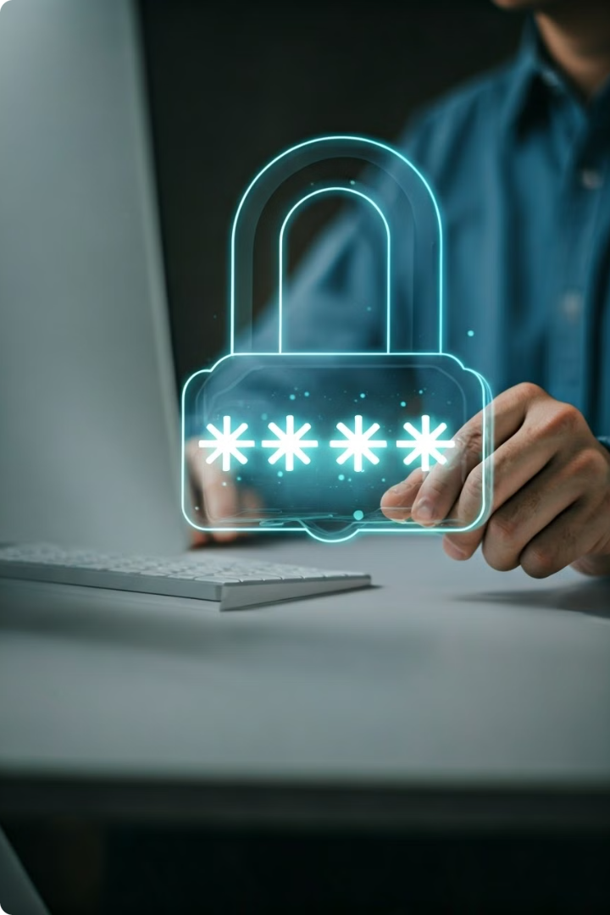
Preventing Account Lockouts
1
Strong Passwords
Use long, complex passwords that are unique for each account. Avoid common words, phrases, or personal information that can be easily guessed.
2
Two-Factor Authentication
Enable two-factor authentication (2FA) on your accounts to add an extra layer of security and prevent unauthorized access.
3
Account Monitoring
Regularly monitor your account activity and login attempts to detect any suspicious behavior and address it promptly.

Slide 6
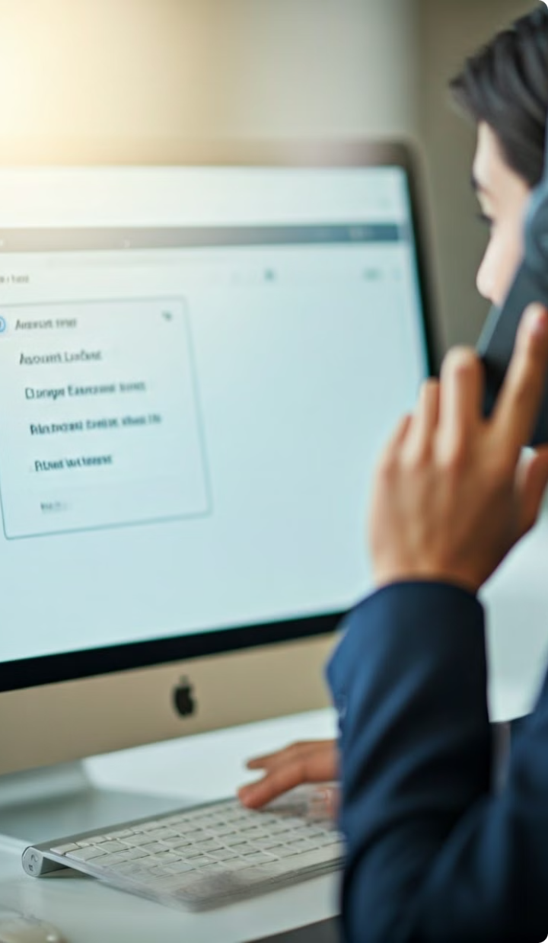




Responding to an Account Lockout
Unlock Account
Contact your system administrator or the service provider to unlock your account and regain access.
Change Password
Once your account is unlocked, change your password to a strong, unique one to prevent future lockouts.
Scan for Malware
If the lockout was caused by malware, run a comprehensive antivirus scan to identify and remove any threats.
Review Security Logs
Check your account's security logs to identify the cause of the lockout and take appropriate action to prevent it from happening again.

Slide 7
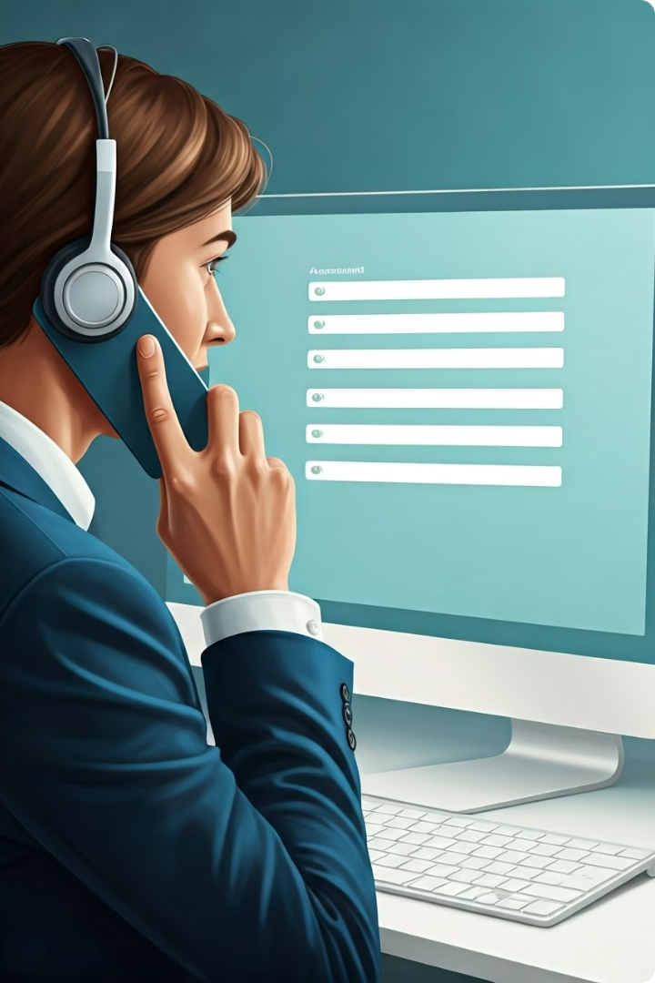
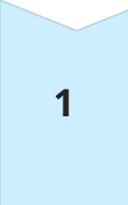
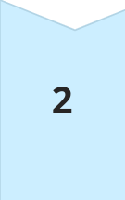
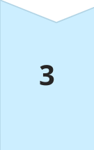
Unlocking a Locked Account
Contact Support
Reach out to your system administrator or the service provider's customer support to request the account to be unlocked.
Verify Identity
You will likely need to provide additional information to verify your identity, such as a valid ID or other authentication methods.
Reset Password
Once your identity is confirmed, you may be required to reset your password before the account can be unlocked.

Slide 8

Best Practices for Account Security
Use Strong Passwords
Implement Two-Factor Authentication
Monitor Account Activity
Keep Software Up-to-Date
Avoid Reusing Passwords
Enable Automatic Lockouts
Regularly Review Logs
Train Employees on Security

